Slide 1
The Most Valued Data Science Skills
Team X: Khyati Naik, Prinon Mahdi, Tyler Brown, John Ledesma and William Jasmine

Slide 2
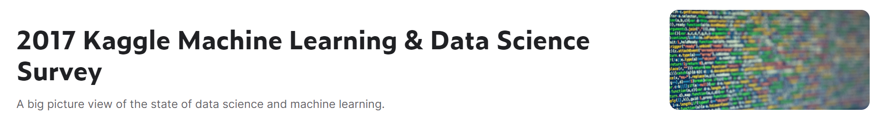
Summary
In order to answer the question of what are the most important data science skills, our team looked at 2017 Kaggle Machine Learning and Data Science Survey.

Slide 3
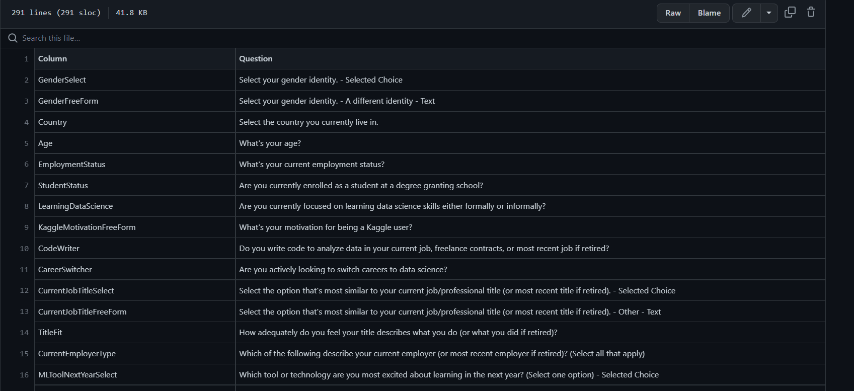
Loading and Cleaning Data
Schema

Slide 4
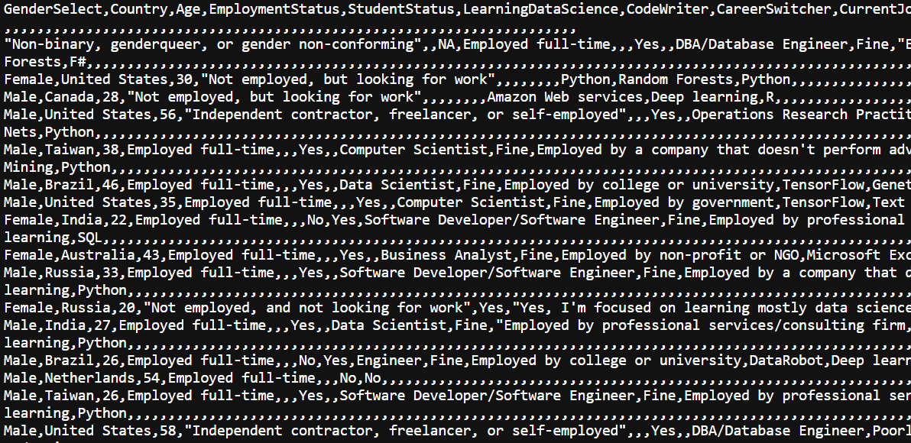
Loading and Cleaning Data
Raw MCQ Data

Slide 5
Loading and Cleaning Data
Raw MCQ Data

Slide 6
Analysis
Criteria for analysis:
Language Recommendation
Most Important DS Tech Skills
Most Important DS Tools
DS tools that are monetarily valued
DS Algorithms that are monetarily valued

Slide 7
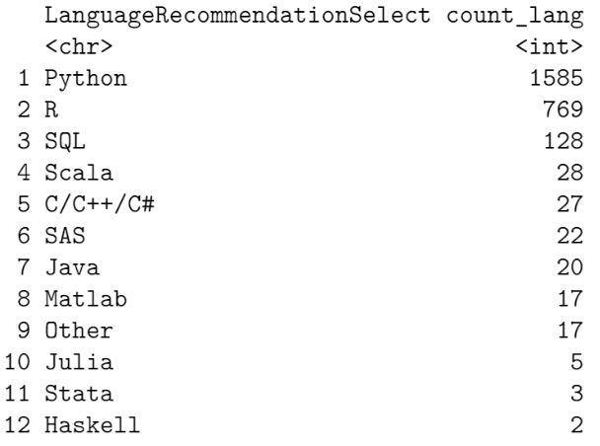

Slide 8
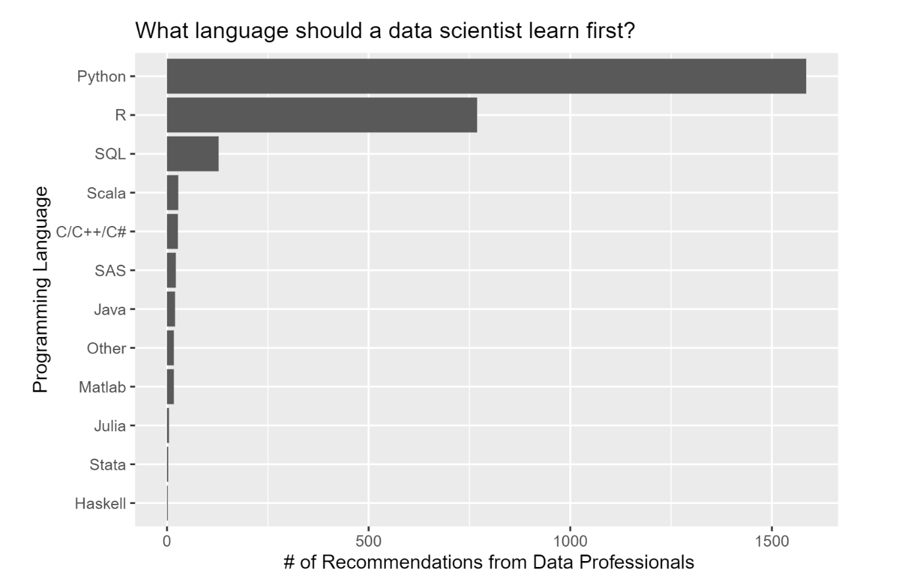

Slide 9
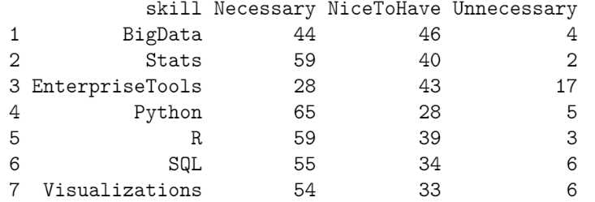

Slide 10
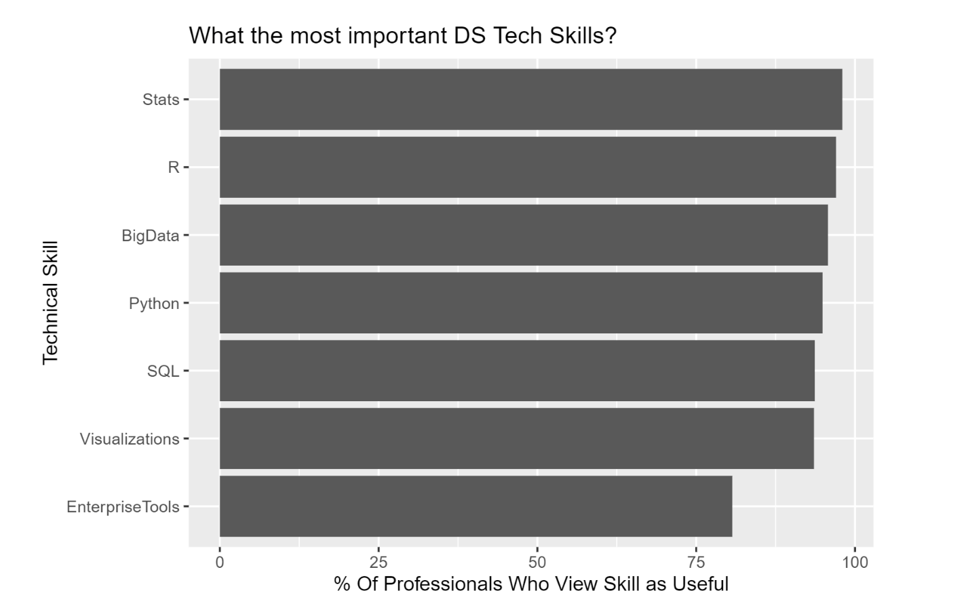

Slide 11
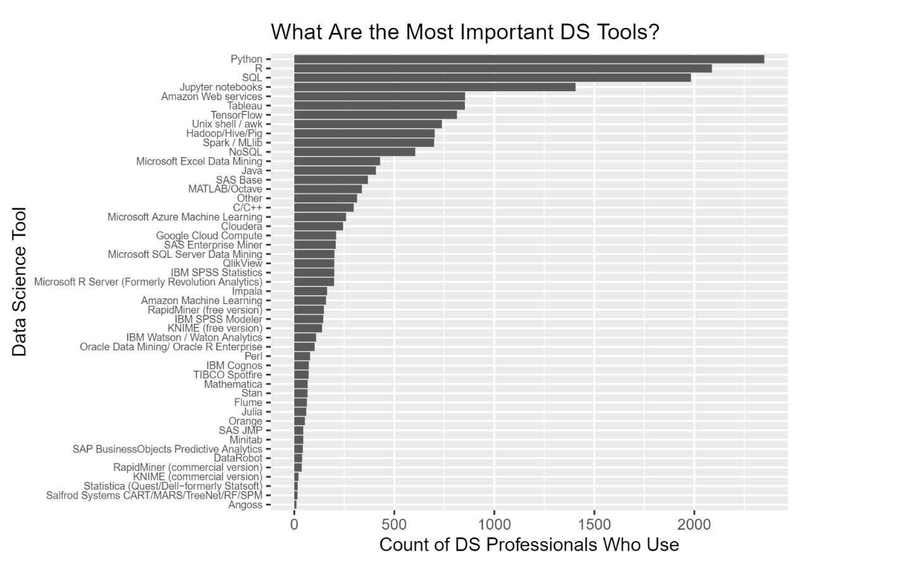

Slide 12
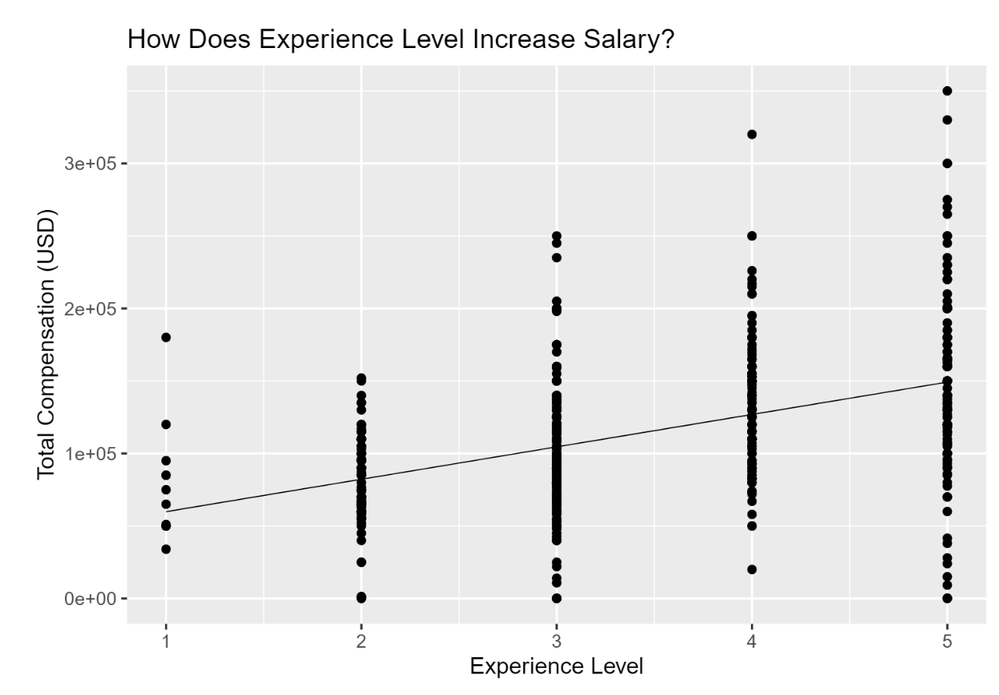

Slide 13
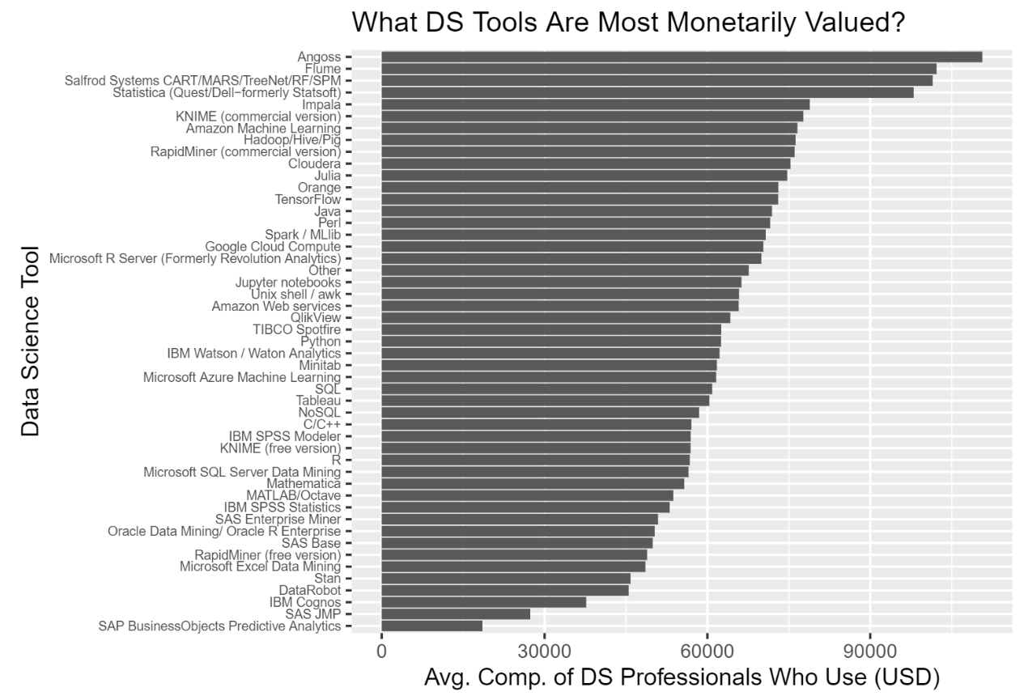

Slide 14
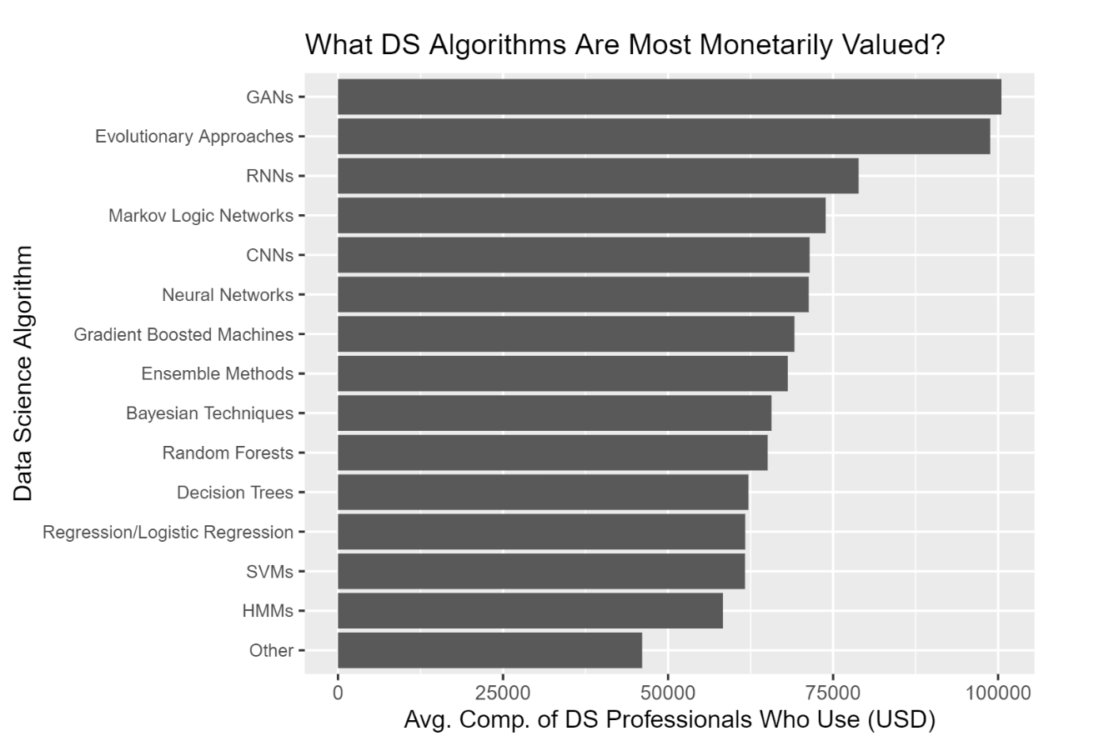

Slide 15
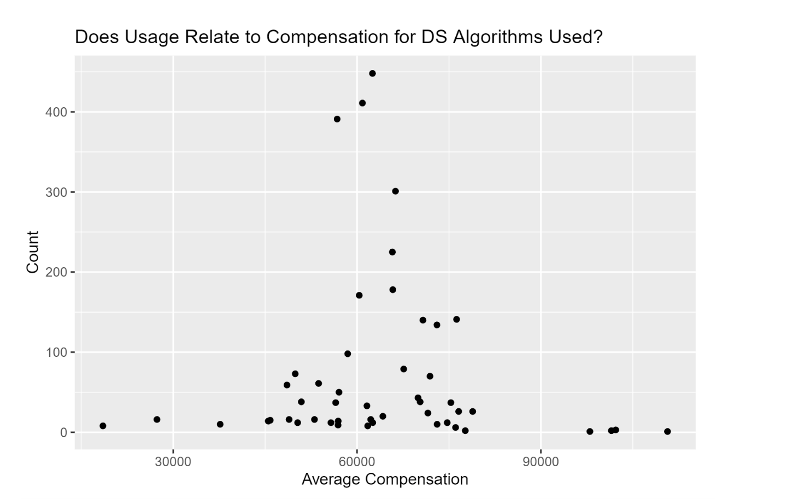

Slide 16
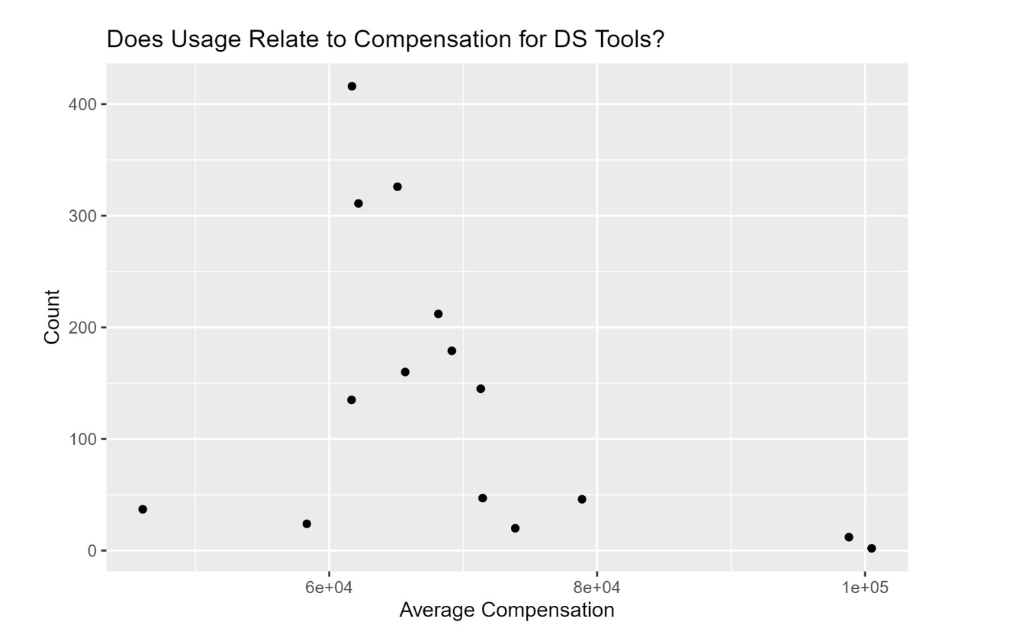

Slide 17
Conclusion
The above results provide us with some interesting conclusions: while there is a clear group of tools and methods that are most used by data science professionals (i.e. Python, SQL, R, etc.), there are some more highly specific skills (i.e. using Angoss, being able to implement GANs) that are less used but might provide a data scientist with a higher compensation. This makes sense, seeing as the skills that might land someone their first DS job are likely to be those that are more generalized. Once spending some time in the industry, more specialized tools will likely provide a more experienced data science professional with higher compensation.
While these results are interesting, the data used is nowhere near from being fully analyzed. The whole data set comprises the responses to about 230 data science related questions meaning that there are likely many more insights that could be drawn. In terms of this analysis, a next step might be to further inspect this negative correlation between compensation and usage via more advanced modelling techniques.

